Slide 1
Exploring ESP32 Connectivity
UCL ENGINEEING, Computer science department

Slide 2
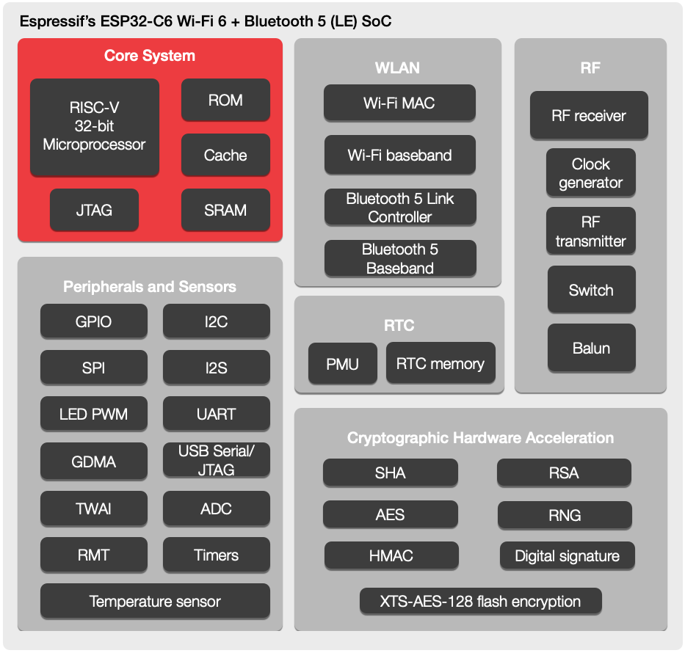
ESP32
Dual-core processing
Integrated Wi-Fi and Bluetooth capabilities
Extensive GPIO (General Purpose Input/Output) pins
It allows IoT devices to exchange data, communicate with the cloud, and operate efficiently within complex IoT ecosystems.

Slide 3
Connectivity Options
Wi-Fi:
Pros:
High-speed wireless connectivity
Suitable for connecting to local networks and the internet
Widely available, making it practical for home and industrial IoT
Cons:
Higher power consumption compared to other options
Limited range, typically within a local network's reach
Bluetooth:
Pros:
Efficient for short-range device-to-device communication
Ideal for applications like wearables, beacons, and proximity-based interactions
Cons:
Limited range (usually up to 100 meters)
Lower data transfer rates compared to Wi-Fi

Slide 4
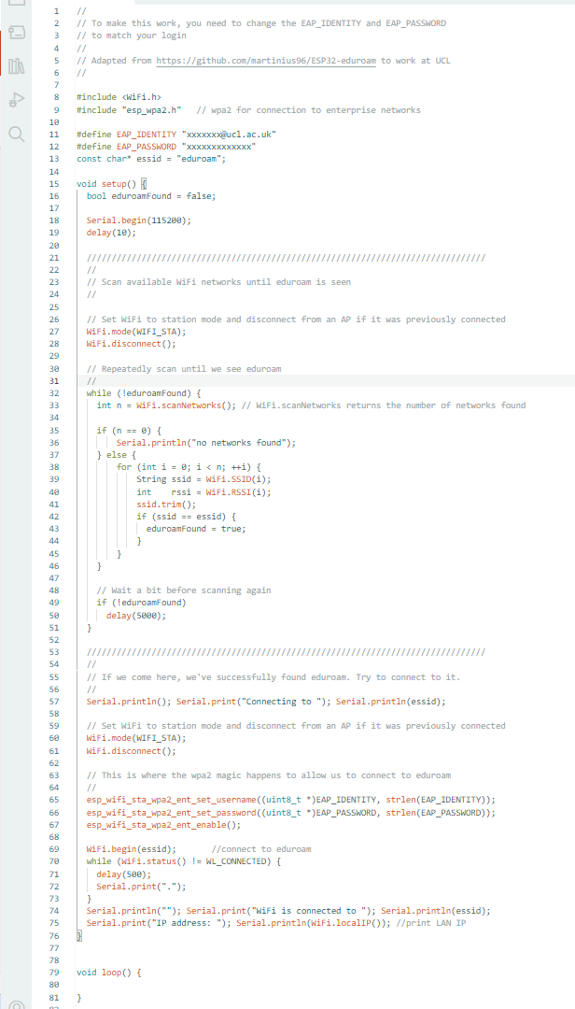
WiFi – Connecting to eduroam
More involved than connecting to a standard Access Point
See Moodle (CS Challenge 1) for code

Slide 5
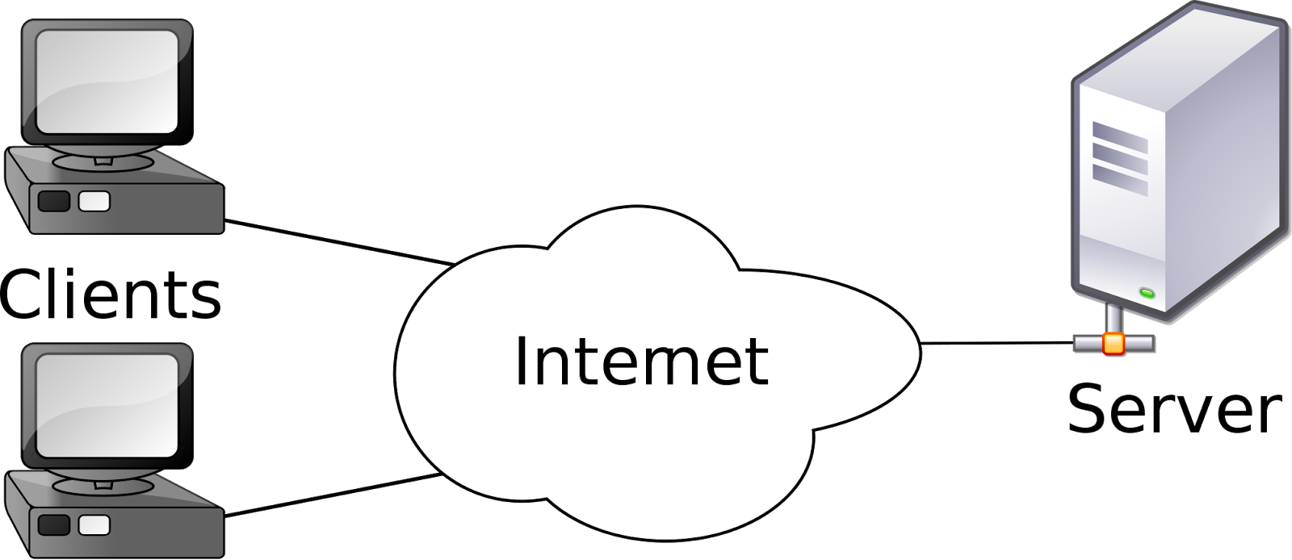
Client – Server Architecture

Slide 6
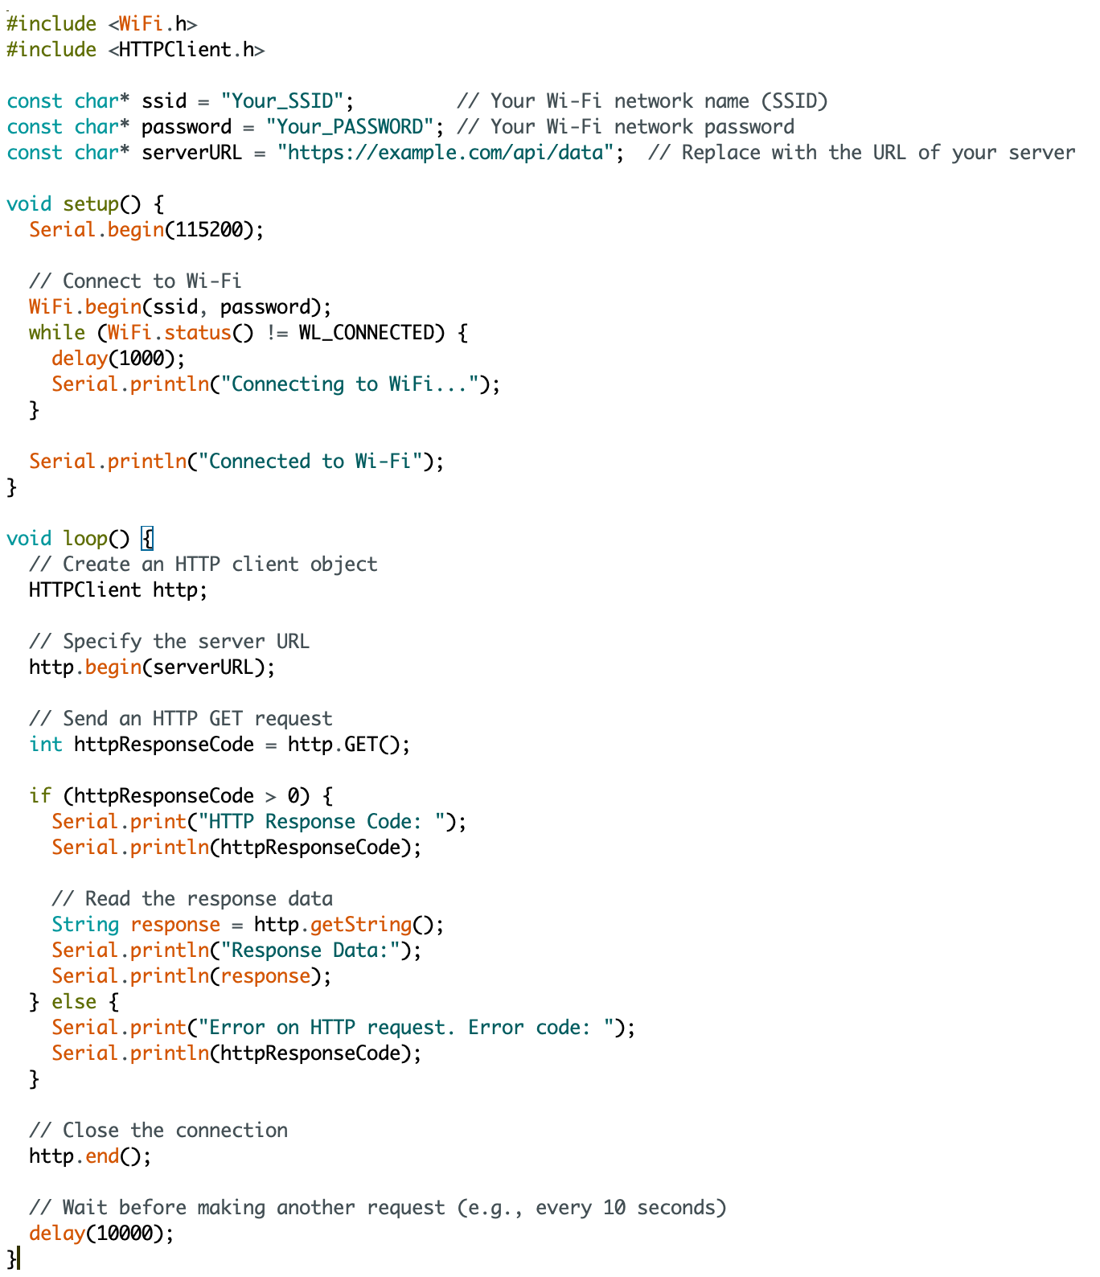
Client-Server Communication

Slide 7
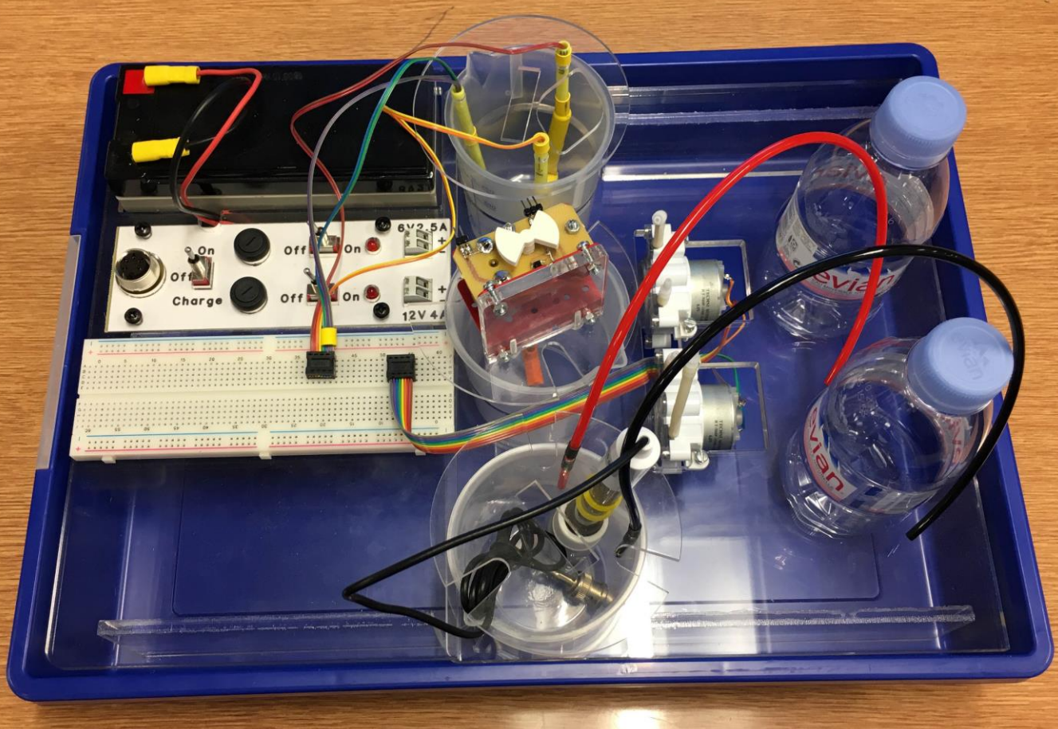
Challenge 2 – Bioreactor
Sensors
Thermistor
pH sensor
Mechanism for measuring motor speed
Actuators
Motors
Heating element

Slide 8
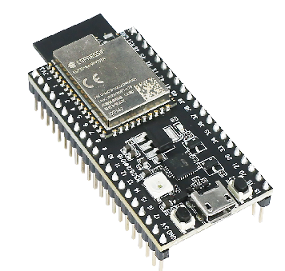
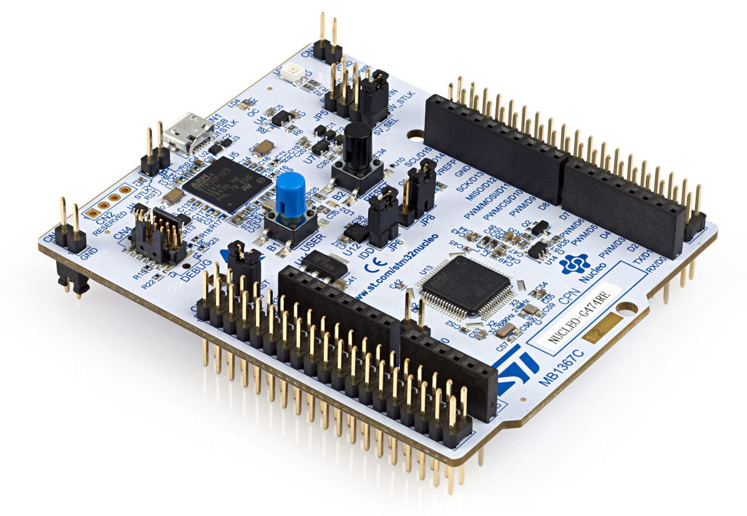
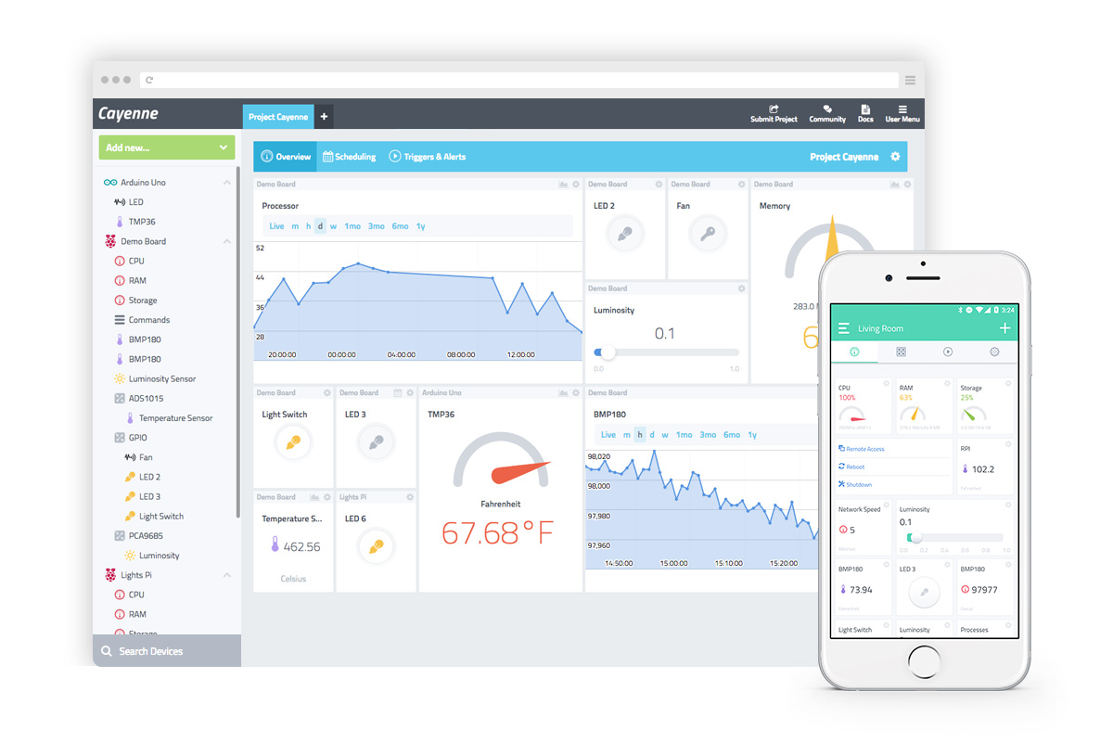
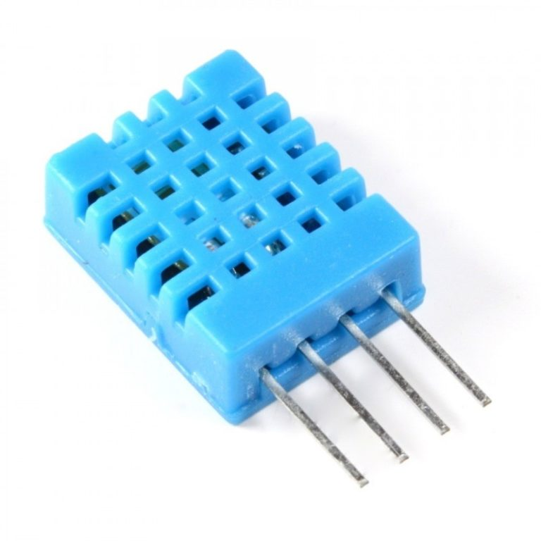
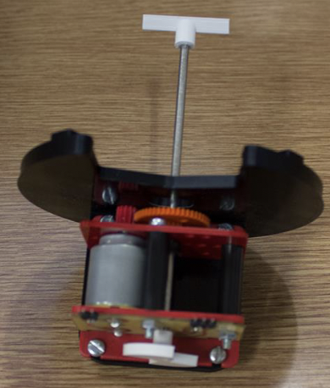
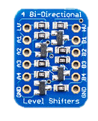
Bioreactor System
Vaccine Production System
WiFi and/or Bluetooth
I2C, UART, SPI
Sensors and Actuators
IoT Dashboard/PC/Phone

Slide 9
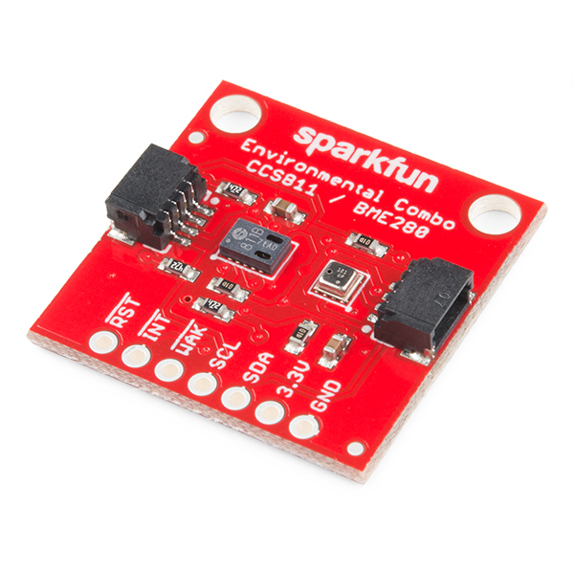
Bioreactor System
I2C, UART, SPI
Sensors and Actuators
Low-level communication is provided for you by ESP32 and Arduino libraries

Slide 10
Connecting ESP32 to External Devices
I2C (Inter-Integrated Circuit): I2C is a two-wire serial communication protocol that enables the ESP32 to communicate with sensors, displays, and other devices. It uses a bus with a controller (ESP32) and one or more reader devices.
SPI (Serial Peripheral Interface): SPI is a synchronous serial communication protocol suitable for high-speed data transfer. It's commonly used to connect with peripherals like displays, SD cards, and other microcontrollers.
UART (Universal Asynchronous Receiver/Transmitter): UART is a simple, asynchronous serial communication protocol used for communication between devices. It's often employed for connecting to sensors, GPS modules, and other devices.

Slide 11
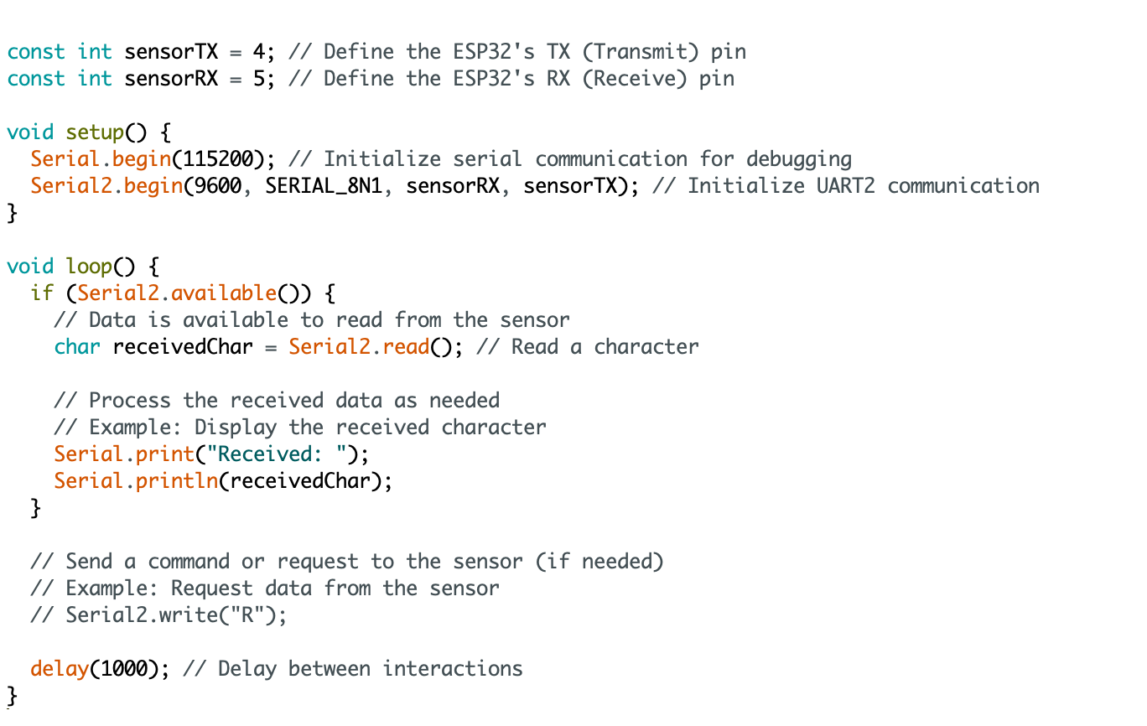
Interfacing with an External Sensor Using UART
Using Serial

Slide 12
Interfacing an External Sensor Using I²C
This example shows how to read a Devantech SRFxx , an ultra-sonic range finder that communicates via the I2C synchronous serial protocol
Include the Wire library to use I2C
Initialize the I2C library and serial communication in the setup() function
// I2C SRF10 or SRF08 Devantech Ultrasonic Ranger Finder
// by Nicholas Zambetti <http://www.zambetti.com>
// and James Tichenor <http://www.jamestichenor.net>
// Demonstrates use of the Wire library reading data from the
// Devantech Utrasonic Rangers SFR08 and SFR10
// Created 29 April 2006
// This example code is in the public domain.
#include <Wire.h>
void setup() {
Wire.begin(); // join i2c bus (address optional for controller)
Serial.begin(9600); // start serial communication at 9600bps
}
...
See https://docs.arduino.cc/learn/communication/wire

Slide 13
Interfacing an External Sensor Using I²C
Set some registers in the sensor so we get the type of readings we want
Common for I2C sensors to have registers that control their operation
Read the datasheet of the sensor to know what these are and how to talk to it
…
int reading = 0;
void loop() {
// step 1: instruct sensor to read echoes
Wire.beginTransmission(112); // transmit to device #112 (0x70)
Wire.write(byte(0x00)); // sets register pointer to the command register (0x00)
Wire.write(byte(0x50)); // command sensor to measure in "inches" (0x50)
Wire.endTransmission(); // stop transmitting
// step 2: wait for readings to happen
delay(70); // datasheet suggests at least 65 milliseconds
// step 3: instruct sensor to return a particular echo reading
Wire.beginTransmission(112); // transmit to device #112
Wire.write(byte(0x02)); // sets register pointer to echo #1 register (0x02)
Wire.endTransmission(); // stop transmitting
...
See https://docs.arduino.cc/learn/communication/wire

Slide 14
Interfacing an External Sensor Using I²C
Read values from the sensor
…
// step 4: request reading from sensor
Wire.requestFrom(112, 2); // request 2 bytes from peripheral device #112
// step 5: receive 2 byte reading from sensor
if (2 <= Wire.available()) { // if two bytes were received
reading = Wire.read(); // receive high byte (overwrites previous reading)
reading = reading << 8; // shift high byte to be high 8 bits
reading |= Wire.read(); // receive low byte as lower 8 bits
Serial.println(reading); // print the reading
}
delay(250); // wait a bit since people have to read the output :)
}
See https://docs.arduino.cc/learn/communication/wire

Slide 15
BUT... we have 2 computers talking
Can actually do this with many devices, but exactly one must be a controller
Two ways we can organise communication:
Controller Reader/Peripheral Sender
Controller Writer/Peripheral Receiver
…. or our code could contain some mixture of these
See https://docs.arduino.cc/learn/communication/wire

Slide 16
Controller Reader Sketch
// Wire Controller Reader
// by Nicholas Zambetti <http://www.zambetti.com>
// Demonstrates use of the Wire library
// Reads data from an I2C/TWI peripheral device
// Refer to the "Wire Peripheral Sender" example for use with this
// Created 29 March 2006
// This example code is in the public domain.
#include <Wire.h>
void setup() {
Wire.begin(); // join i2c bus (address optional for controller)
Serial.begin(9600); // start serial for output
}
void loop() {
Wire.requestFrom(8, 6); // request 6 bytes from peripheral device #8
while (Wire.available()) { // peripheral may send less than requested
char c = Wire.read(); // receive a byte as character
Serial.print(c); // print the character
}
delay(500);
}
See https://docs.arduino.cc/learn/communication/wire

Slide 17
Peripheral Sender Sketch
// Wire Peripheral Sender
// by Nicholas Zambetti <http://www.zambetti.com>
// Demonstrates use of the Wire library
// Sends data as an I2C/TWI peripheral device
// Refer to the "Wire Master Reader" example for use with this
// Created 29 March 2006
// This example code is in the public domain.
#include <Wire.h>
void setup() {
Wire.begin(8); // join i2c bus with address #8
Wire.onRequest(requestEvent); // register event
}
void loop() {
delay(100);
}
// function that executes whenever data is requested by controller
// this function is registered as an event, see setup()
void requestEvent() {
Wire.write("hello "); // respond with message of 6 bytes
// as expected by controller
}
See https://docs.arduino.cc/learn/communication/wire

Slide 18
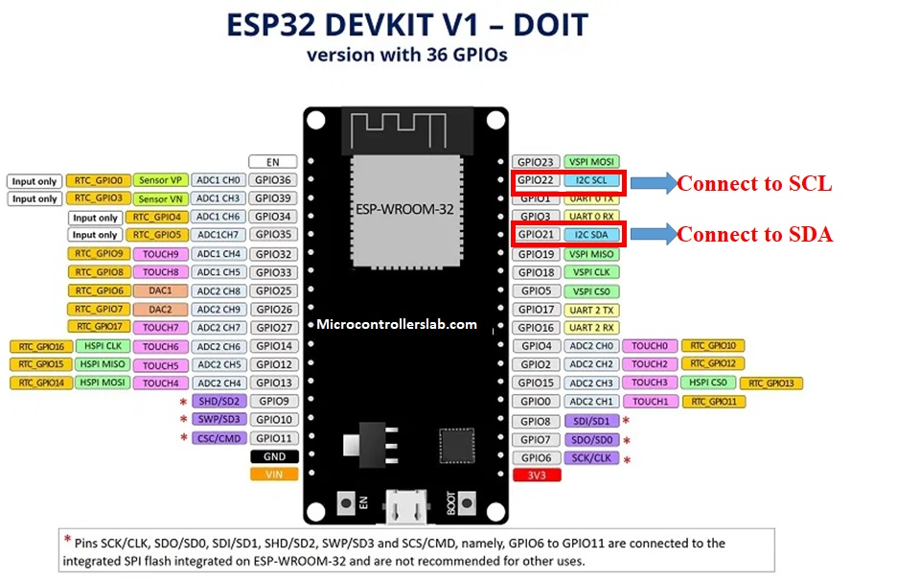
Inter-Intergrated Circuit - I2C

Slide 19
How I2C works
Message
Start
7 to 10 Bits
Read/Write Bit
ACK/NACK Bit
8 Bits
ACK/NACK Bit
8 Bits
ACK/NACK Bit
Stop
Start Condition
Address Frame
Data Frame 1
Data Frame 2
Stop Condition

Slide 20

Thingsboard

Slide 21
ESP32 to IoT
MQQT
IoT Dashboard/PC/Phone
MQTT – Message Queuing Telemetry Transport

Slide 22
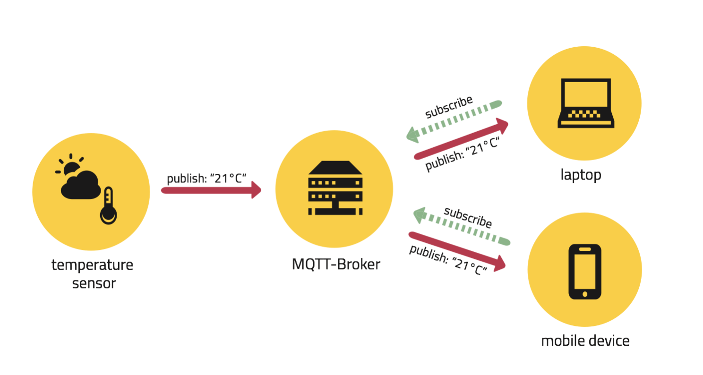
MQTT – example
MQTT broker (Server)
MQTT client (publisher and subscriber)

